Slide 1
CHESS FOR KIDS
Lesson 1

Slide 2
Lesson Goals
What is chess?
Chess facts.
Chess history.
Why learn chess?

Slide 3
What Is Chess?
A game.
A sport.
An art.
All of the above!

Slide 4
What Is Chess?
A game for only two players played on an 8x8 board where the object is to capture the opponents king.

Slide 5
What Is Chess?
Chess requires a lot of mental skill.
It can be played indoors or outdoors.
It is played on a board with 64 squares of alternating colors.
There are 32 chess pieces...16 for each player.

Slide 6
What Is Chess?
All of a player’s pieces are the same color.
The objective is to capture the king.
Eliminating many of your opponent’s pieces and controlling the board are secondary objectives.

Slide 7
What Is Chess?
The game can end in a draw with no winner.
Each piece has its own unique rules of movement.
A piece is captured by landing on the space the captured piece occupies.

Slide 8
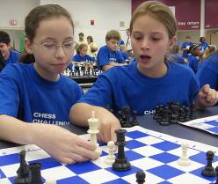
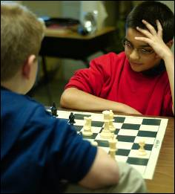
Chess Facts
Almost 30 nations integrate chess into their school curricula.

Slide 9

Chess Facts
The FIDE (International Chess Federation) is the 2nd largest sporting organization in the world!

Slide 10
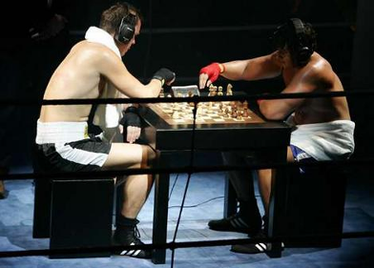
Chess Facts
Chess is recognized as a sport in over 150 countries worldwide.

Slide 11
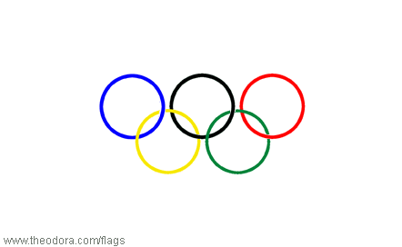
Chess Facts
Chess was played as an exhibition sport in the 2000 Olympics in Sydney, Australia.

Slide 12
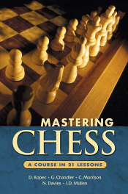
Chess Facts
There are more books written on chess than any other sport.

Slide 13
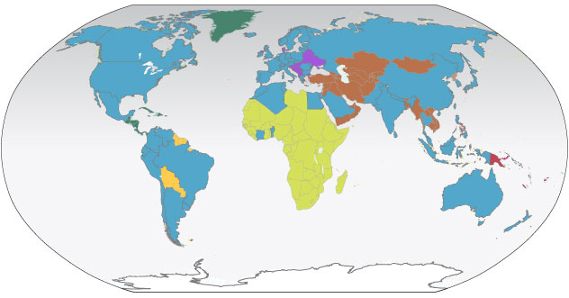
Chess History
Chess is believed to have originated in northern India or Afghanistan before the year 600 A.D.

Slide 14
Chess History
As the world’s population grew and nation’s began to trade with each other chess moved to the rest of Asia and then Europe.

Slide 15
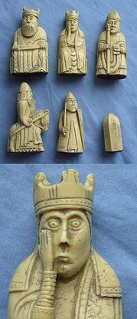
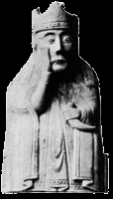
Chess History
Examples of early chess pieces.

Slide 16
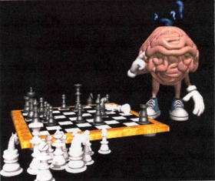
Why Learn Chess? Who Cares?
Chess helps to develop higher order thinking skills. It will help you with your verbal, mathematical, and memory skills.

Slide 17

Why Learn Chess? Who Cares?
Because your teacher said so!

Slide 18
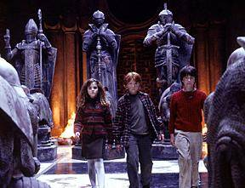
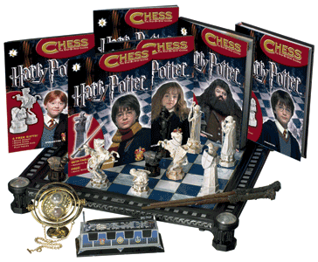
Why Learn Chess? Who Cares?
They played it in Harry Potter!

Slide 19
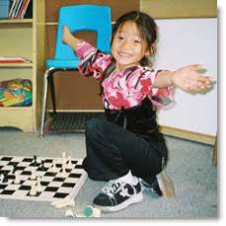
Why Learn Chess? Who Cares?
It is fun, and you might just learn something!

Slide 20
Review
Chess is a game for two players.
The player that captures the king wins.
Chess is believed to have originated from northern Indian and/or Afghanistan around the year 600 A.D.

Slide 21
CHESS FOR KIDS
Lesson 2

Slide 22
Lesson Goals
Get to know the board.
Board orientation.
Files and ranks.

Slide 23
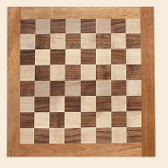
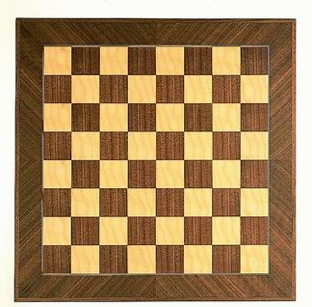
Chess Basics – The Board
A chess board looks very much like a checker board.

Slide 24
Chess Basics – The Board
A chess board has 64 squares of alternating colors. 8 rows and 8 columns.

Slide 25
Chess Basics – The Board
The colors a chess board is made up of can be any two contrasting colors.
White and Black are very common.
Chess piece colors may or may not match the board colors.

Slide 26
Chess Basics – The Board
The board must be placed with a light square at each player’s right.
“Light goes on the right.”
Player 1 sits here.
Player 2 sits here.

Slide 27
Chess Basics – The Board
The rows are called RANKS.
There are 8 rows.

Slide 28
Chess Basics – The Board
The columns are called FILES.
There are 8 columns.

Slide 29
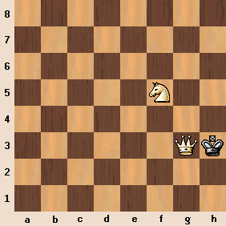
Chess Basics – The Board
The ranks (rows) are numbered from 1 – 8.

Slide 30
Chess Basics – The Board
The files (columns) are labeled from a – h.

Slide 31
Chess Basics – The Board
The knight is on f5.
The king is on h3.
The queen is on g3.

Slide 32

Chess Basics – The Board
DON’T WORRY! You can play without knowing this, but you should be familiar with the terms.

Slide 33
Review
A chess board has 8 rows and 8 columns.
Players sit on opposite sides of the board.
The board must be turned so that the each player's right corner has a white (light colored) square.
Rows are referred to as ranks and are labeled 1-8.
Columns are referred to as files and are labeled a-h.

Slide 34
CHESS FOR KIDS
Lesson 3

Slide 35
Lesson Goals
Get to know the pieces.
Rook.
Bishop.
Queen.
King.
Knight.
Pawn.

Slide 36
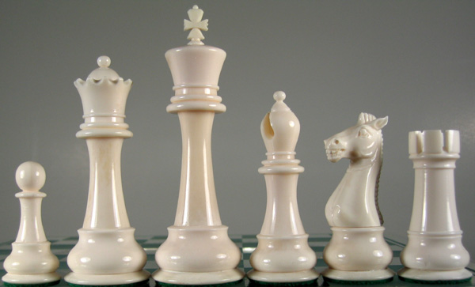
Chess Basics – The Pieces
There are 32 pieces in chess (only 6 are unique).
Each player gets 16 pieces of the same color.
Each player starts with the same 16 pieces in the same positions.

Slide 37
Chess Basics – The Pieces
The 6 unique pieces are:
  The pawn -The rook
  The knight -The queen
  The bishop -The king

Slide 38
Chess Basics – The Rook
  Each player starts with 2.
  A rook can move horizontally or vertically forwards or backwards.
  A rook moves until it captures or hits a piece of the same color.

Slide 39
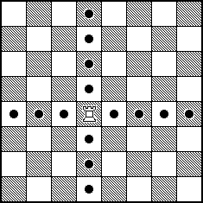
Chess Basics – The Rook

Slide 40
Chess Basics – The Bishop
  Each player starts with 2.
  The bishop moves in a straight diagonal line forwards or backwards.

Slide 41
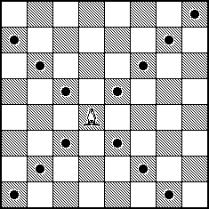
Chess Basics – The Bishop

Slide 42
Chess Basics – The Queen
  Each player starts with 1.
  The queen moves like the rook and bishop combined.
  The most powerful piece.
  Always starts on a square of her own color.

Slide 43
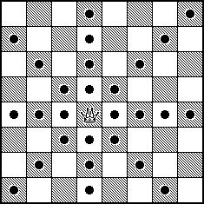
Chess Basics – The Queen

Slide 44
Chess Basics – The King
  Each player starts with 1.
  Moves like the queen except only one square at a time.
  The most valuable piece.
  Always starts on a square that is NOT his color.

Slide 45
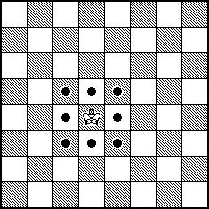
Chess Basics – The King

Slide 46
Chess Basics – The Knight
  Each player starts with 2.
  Moves 2 squares horizontally or vertically and then one square diagonally.
  The ONLY piece that can jump other pieces.

Slide 47
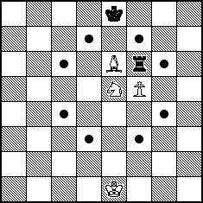
Chess Basics – The Knight

Slide 48
Chess Basics – The Pawn
  Each player starts with 8.
  Least powerful piece with the most complicated rules.
  The pawn typically moves one square forward.
  There are 3 exceptions to this rule.

Slide 49
Chess Basics – The Pawn
  A pawn may only attack diagonally.
  A pawn may move 2 squares forward on only its first move.
  There is a special capture a pawn can make called “en passant”.

Slide 50
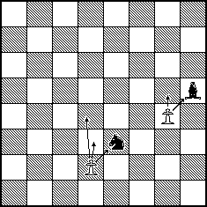
Chess Basics – The Pawn

Slide 51
Review
  Each piece has its own unique rules of movement.
  The knight is the only piece that can “hop” other pieces.
  The queen is the most powerful.
  The king is the most valuable.

Slide 52
CHESS FOR KIDS
Lesson 4

Slide 53
Lesson Goals
Setting up the board.
Rules, rules, rules.

Slide 54
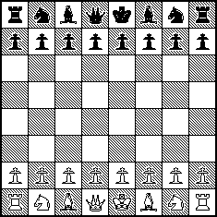
Setting Up The Board
The board must be oriented so that the square in the right corner facing each player is white.
The queen must be on a square of her own color.
Follow the diagram below.
Player 2
Player 1

Slide 55
Additional Rules - General
White (or light color) goes first.
You capture another player’s piece by moving into the square that piece occupied.
The game ends when there is a checkmate, stalemate, or a draw (more on this later).
A player may resign (quit and loose) at any time.
A player may propose a draw after his/her turn.

Slide 56
Additional Rules – Promotion
A pawn that makes it to the other side of the board may be promoted to any other piece.
A queen is nearly always chosen because of its power.
Yes, you can have two queens on the board at once.
If a piece can be captured, a player may decide not to capture it.

Slide 57
Additional Rules – Touching
When a player touches one of his/her own pieces, then he/she must make a legal move with this piece, if possible.
When a player touches one of his/her opponents pieces, then he/she must capture this piece if possible.
When castling, the king must be the first piece touched.
J’adoube – “I adjust”

Slide 58
Additional Rules – En Passant
This is a special capture technique for pawns and very rare.
It only applies to pawns that move 2 squares on the first move.
If the pawn could have been captured on the first square, the other player can capture it only on the next turn.

Slide 59
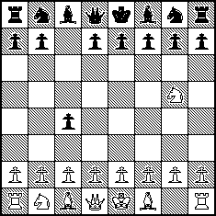
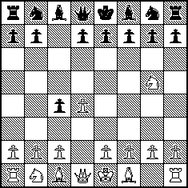
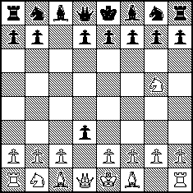
Additional Rules – En Passant

Slide 60
Additional Rules – Castling
The king and rook can move at the same time if the following is true:
  The king and rook involved haven’t moved.
  The king is not in check before, during, or after the move.
  All squares between the rook and king before the castling move are empty.
  The king moves 2 square towards the rook, and the rook moves over the king to the next square.

Slide 61
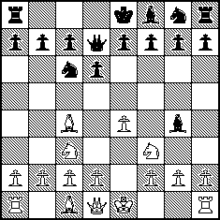
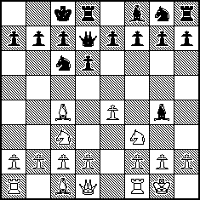
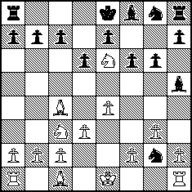
Additional Rules – Castling
Black cannot castle!

